Slide 1

AN Oral Presentation ON
STUDENT INDUSTRIAL WORK EXPERIENCE SCHEME (SIWES).
Undertaken at: FUTA RADIO (93.1 FM), AKURE, ONDO STATE.
FROM JULY, 2025 TO NOVEMBER, 2025.
Presented by: OYEWALE PRUDENCE CHIDINMA(CPE/20/5631)

Slide 2
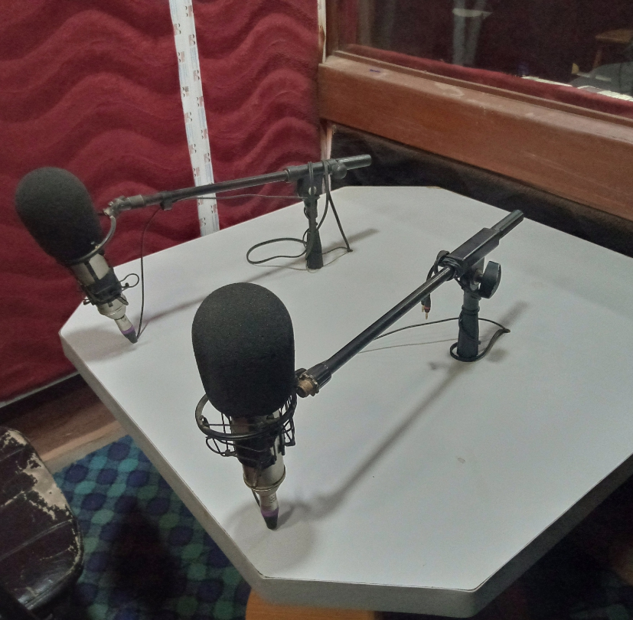
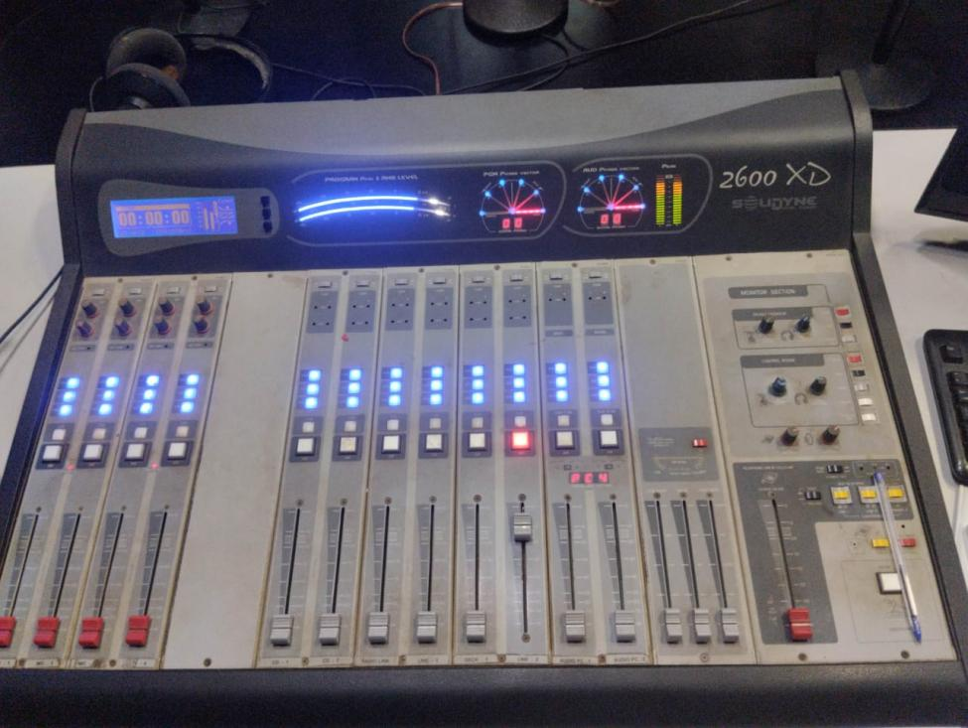
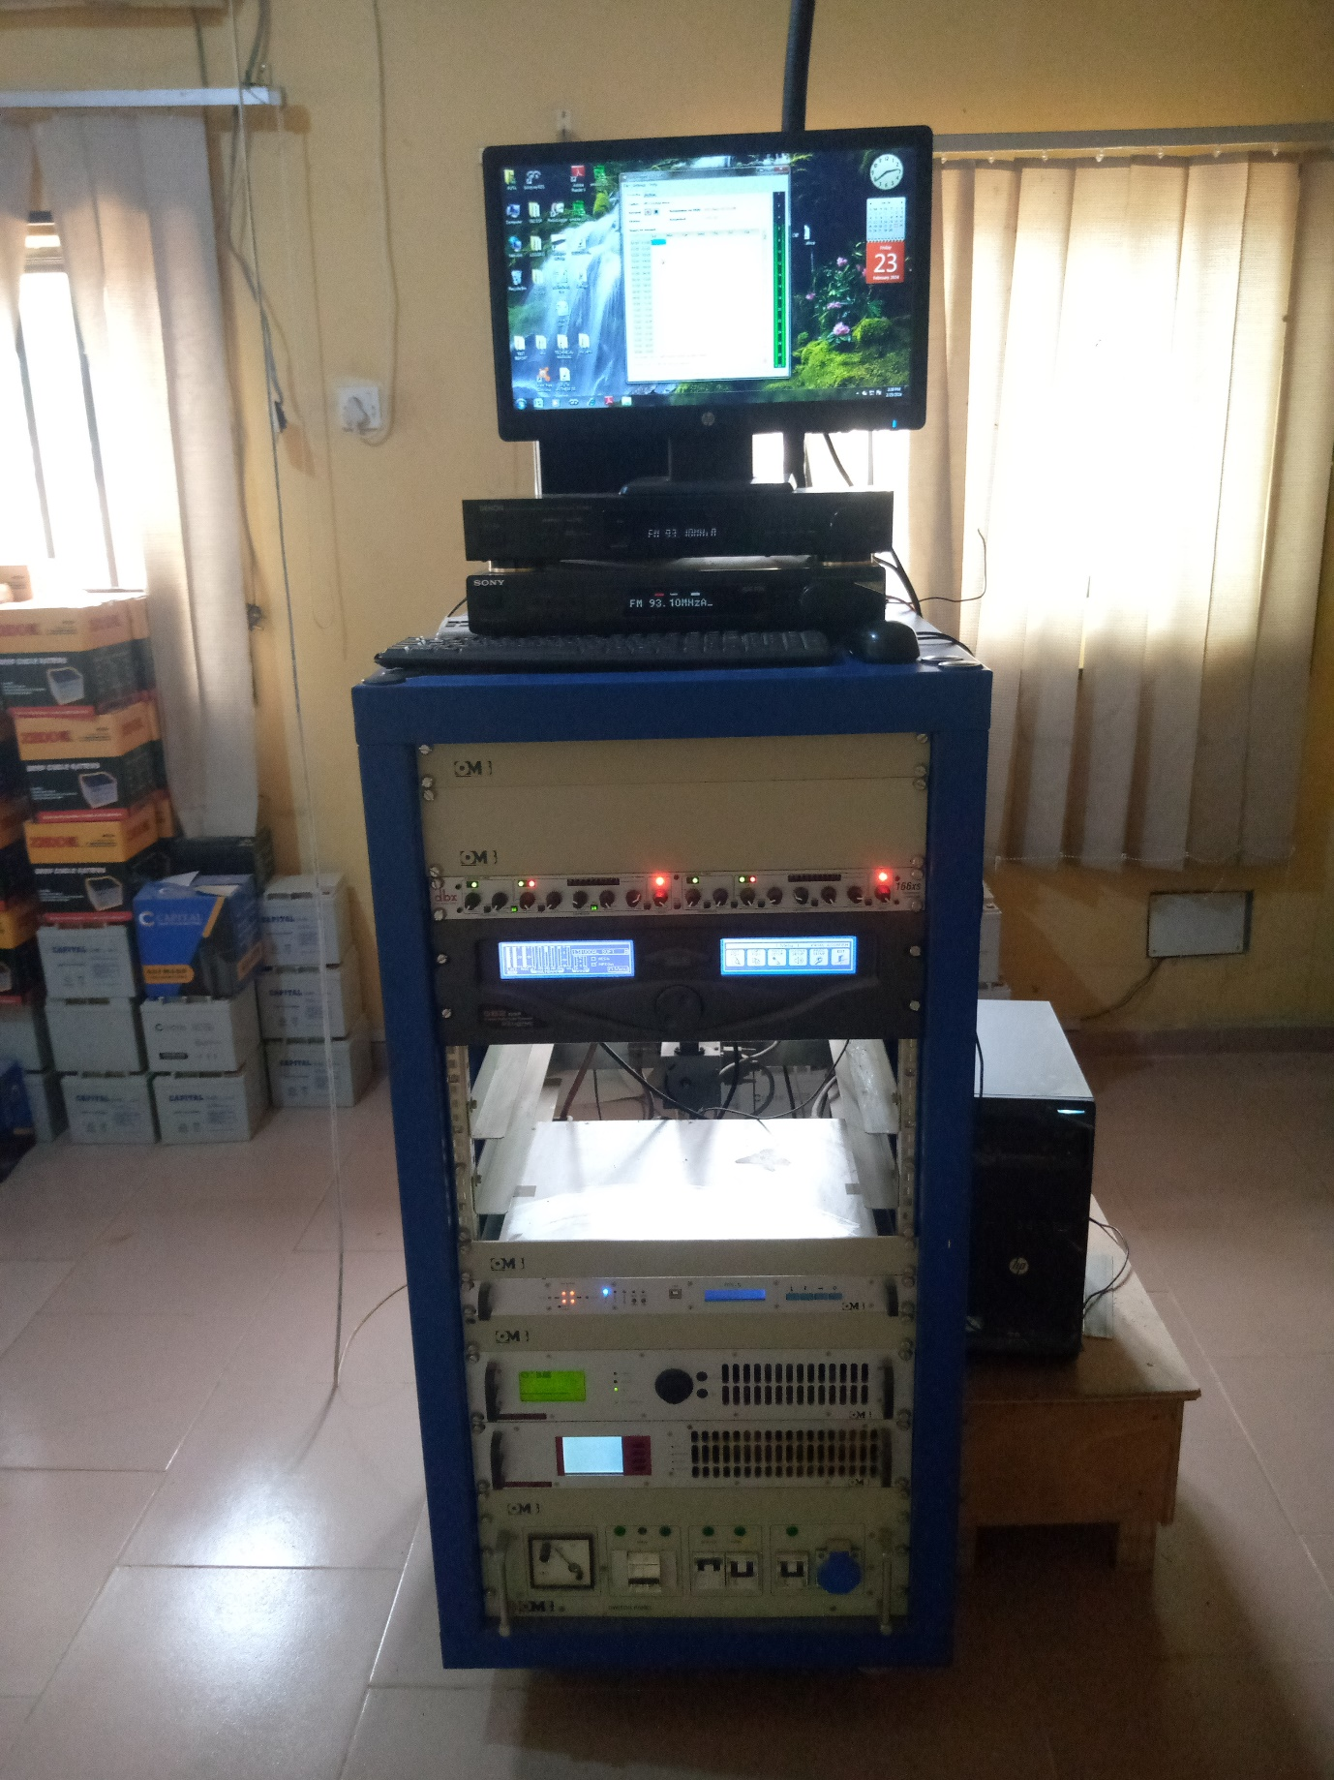
ENGINEERING Department & Units Worked In
Engineering Department Units:
    Production/Transmission Unit
    Sound & Editing Unit
    Electrical/Power Unit
My Primary Work Areas:
  Live Studio — program production
  Recording Studio — sound editing
  Transmitter Room — RF equipment handling

Slide 3
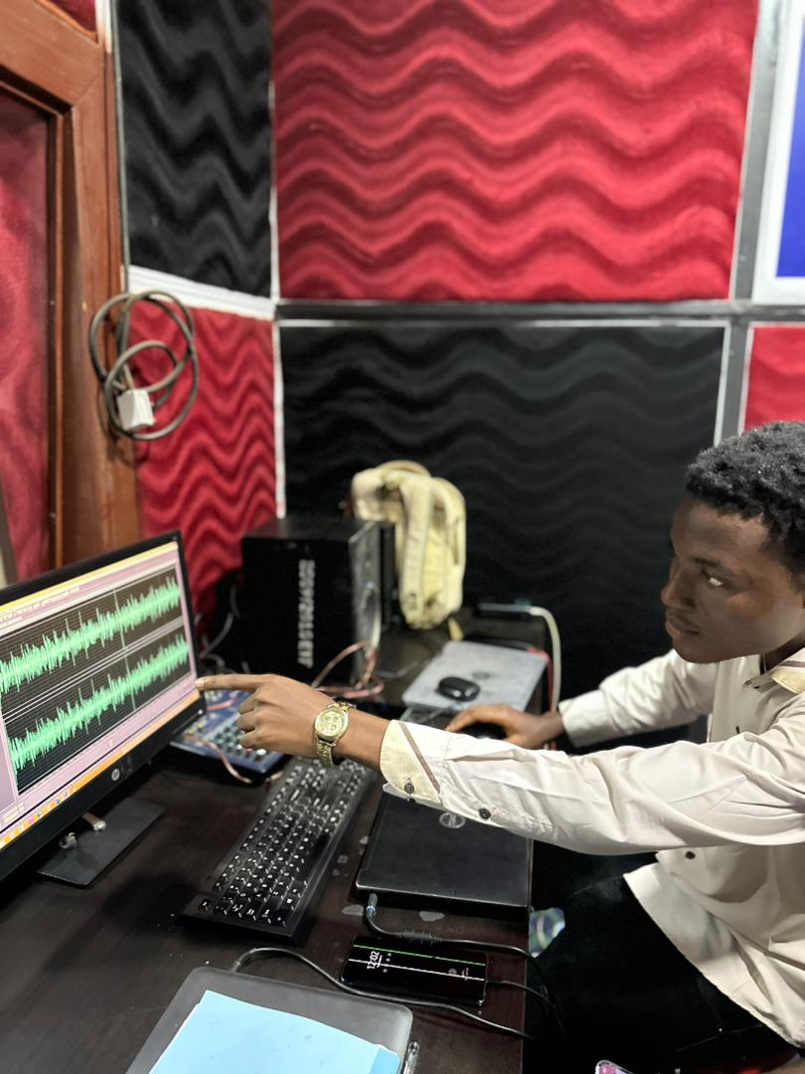
Tasks and responsibilities
Live Studio (Production):
    Setting up the condenser microphones and transmitter room.
    Transmission of live programs.
    Coordination with Broadcasting Team.
Recording Studio (Audio Editing):
    Editing voiceovers in Adobe Audition
    Removing noise, adjusting decibels
    Adding effects, exporting broadcast-ready audio

Slide 4
ACHIEVEMENTS AND LEARNING
Knowledge of signal transmission.
Audio Engineering
Troubleshooting of technical issues such as Equipment failure, outdated software and cable/connection failure.
Gained valuable soft skills like teamwork and effective communication.
PROJECT DONE
Tasked with setting up the studio for live programs broadcast as team work.
Documentation of routine work.

Slide 5
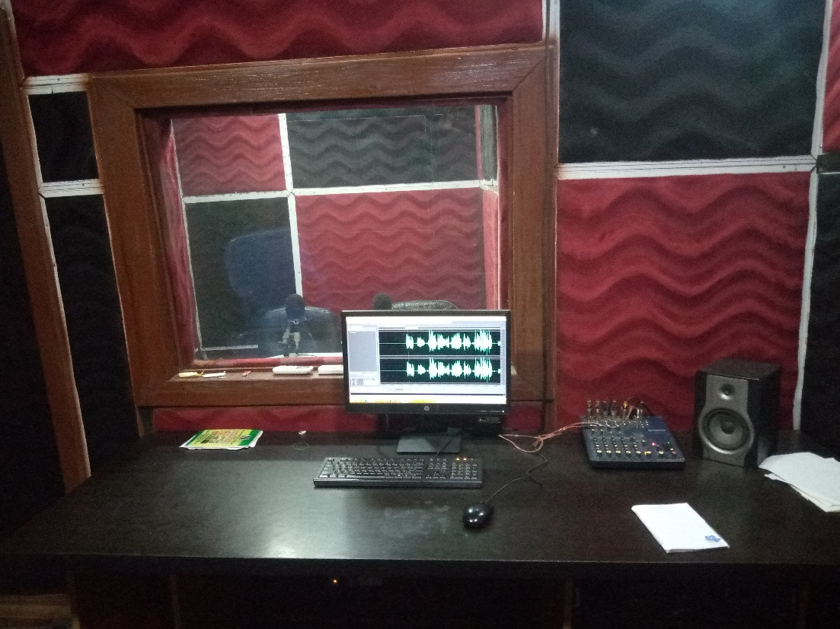
Challenges faced
Microphone Sensitivity Issues:
  Required recalibration & proper gain structure
Outdated Devices and Audio Console Channels:
  The devices couldnot run the software effectively Some ports produced noise; required cable tracing
Occasional Transmitter Room Overheating:
  Learned to monitor cooling cycles & AC efficiency
Power Fluctuations:
  UPS load balancing & surge protection monitoring

Slide 6
Recommendations
Upgrade aging studio consoles & UPS systems
Implement preventive maintenance schedule
Provide advanced RF engineering workshops for IT students
Improve cooling in the transmitter room

Slide 7
Conclusion
SIWES at FUTA Radio strengthened my practical competence in:
Broadcast Engineering
Signal Transmission
Studio Operations
Audio Processing
Power & Equipment Management
This experience prepared me for stronger performance as a Computer Engineering student and future broadcast/communication engineer.

Slide 8
Thank you for listening
OYEWALE PRUDENCE CHIDINMA

